Slide 1
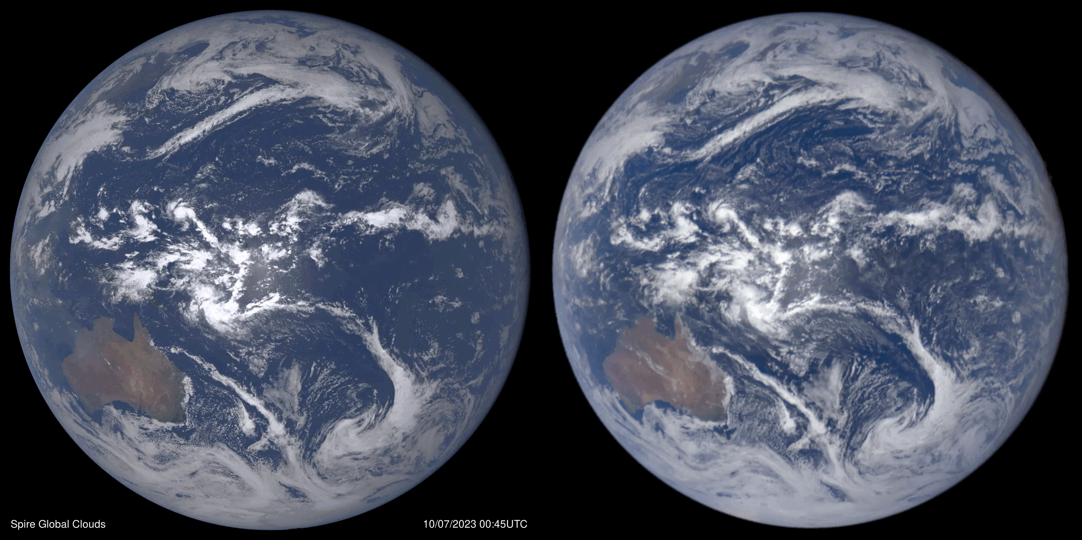

SIMULATED
(Spire Analysis)
Full Disk Earth View
OBSERVED (DSCOVR)
Clouds, Aerosols, Sun Glint, Snow & Ice Full Rotation October 7, 2023
Notes:
Since the simulated imagery software can look both up and down it uses spectral albedo information from a land surface database. Anisotropic Reflectance Factor (ARF) is specified according to land surface type. Over the ocean a sun-glint model is employed. The colors here are designed to be “natural” color. In principle an astronaut could hold their laptop up to the window and see similar colors and contrasts as the Earth. Comparisons of color imagery with Geosynchronous satellites or VIIRS are also possible. Cloud analysis is from E-LAPS allowing a close match in the smaller-scale cloud features compared with the observed in visible wavelengths.

